Slide 1
NYF Partnership Grant Call
(Nov 24 – Feb 25)
Confidence
Tenacity
Empathy
Social Support Networks
Mental Wellbeing: Emotional Awareness; Emotional Management; Emotional Support
Financial Literacy
DRIVEN & RESILIENT
Our youths possess the confidence and grit to achieve their goals and overcome challenges.
THRIVING
& HEALTHY
ROOTED
& CARING
Our youths are well-adjusted physically and emotionally.
Our youths have a deep connection with Singapore and want to contribute back to the nation.

Slide 2

21 November 2024 – 19 February 2025
Caring for self
Caring for others
Objective: Build intrapersonal and interpersonal resources within youths to enable them to manage their well-being and self-help.
Outcome: Youths are thriving and having a positive sense of well-being
Objective: Strengthen quality of support provided by their peers, family and colleagues for their youths to create a robust culture of care.
Outcome: Youths/ Stakeholders are equipped with knowledge and skills to strengthen their own well-being and support others
Notes:
(i) Wellbeing - Promote Holistic Well-Being and Self-Empowerment (Youth)
(ii) Wellbeing - Strengthen Support Systems (Youth's Social Environment)

Slide 3
Themes | Target Audience | Youth Development Outcomes (YDOs)*
1) Caring for Self: Holistic Well-Being Objective: Build intrapersonal and interpersonal resources within youths to enable them to manage their well-being and self-help. Outcome: Youths are thriving and having a positive sense of well-being Resilience: Develop confidence, adaptability, and effective coping strategies to deal with and recover from stressors surrounding future uncertainty and emerging adulthood. Self-management: Improve self-awareness of personal needs and the ability to monitor and manage well-being in daily life. Help-seeking: Enhance readiness and efficacy in navigating well-being resources and accessing/ utilising support in schools, workplaces and community to address their needs effectively. Social capital: Acquire skills to identify and build support networks in their communities to cultivate a sense of belonging and stability during periods of transition. | Youth Participants | Future-ready Confidence Tenacity
2) Caring for Others: Strong Support Systems (Peers, Family & Workplace) Objective: Strengthen quality of support provided by their peers, family and colleagues for their youths to create a robust culture of care. Outcome: Youths/ Stakeholders are equipped with knowledge and skills to support others in improving their well-being Interpersonal awareness: Improve ability to observe, recognise, and understand the emotions, needs, and concerns of others. Responsive support: Enhance readiness to take action to support others in a way that is responsive and empathetic to their needs. | Youth Volunteers Youth Leaders If non-youths are being trained to provide support for youths, will need to show impact on youth participants | Committed to SG Empathy
Please refer to Annex A for the Pre-Post and Post-only indicators.

Slide 4
NYF partnership grant call general information
NYC is inviting partners to submit proposals for the NYF Youth Programmes/ Capability Development (YPCD) grant.
Applications will only be accepted during the partnership grant call period (21 November 2024 – 19 February 2025). Projects should fall within the specified themes, unless otherwise specified, and will be evaluated on a first-come, first-served basis.
Eligibility Criteria
All organisations must be registered in Singapore
  Not-for-profit organisations or not-for-profit young start-ups
  Social Service Agencies (SSAs)
  Institutes of Higher Learning (IHLs)
  Social Enterprises (SEs), whose business or key initiatives are primarily focused on engaging and developing youths
Projects must be targeted at youths (aged 15 to 35 years old) and involve Singaporeans/ Singapore Permanent Residents (PRs).
Projects should not undermine Government agencies/ public institutions.
Projects should not have content held objectionable by the public, or that may adversely affect social cohesion in Singapore.
Project should not be utilised as platforms to solicit feedback on or suggest changes to Government policies.
Projects which have not started.

Slide 5
NYF partnership grant call general information
Funding Considerations
Project should:
Address a critical gap or emerging youth need.
Align with NYC's strategic focus and priority area.
Possess a unique value proposition and creates impact in the youth/youth sector.
Include sufficient risk mitigation strategies and impact evaluation.
Involve broad and diverse youth audiences, especially those requiring more support, such as vulnerable youth.
Funding Quantum
For projects that falls within a priority theme, successful applicants can receive funding of up to 80% of total allowable project cost, capped at $100,000 per project.
For projects outside of the grant call priority themes (i.e. Others), NYF grant will be capped at a maximum of $50,000 per project, or up to 80% of total allowable project cost, whichever is lower.
Projects that demonstrate exceeding merits in terms of project scale and impact may be considered for higher funding, beyond $100,000 per project. These applicants will be required to pitch the project to an external panel for evaluation. Invitation to pitch does not constitute a guarantee of grant approval.
Please note that the NYF grant goes towards the project deficit.

Slide 6
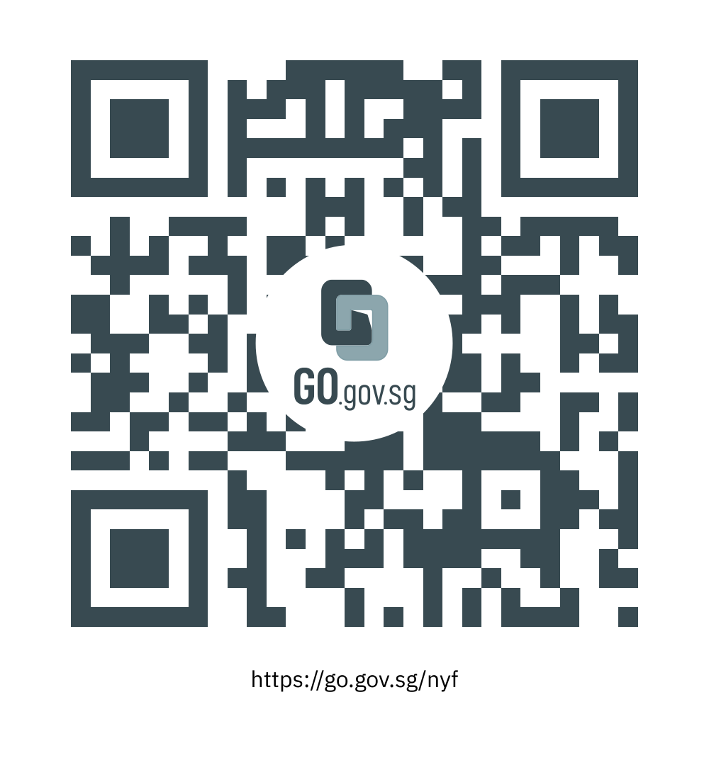
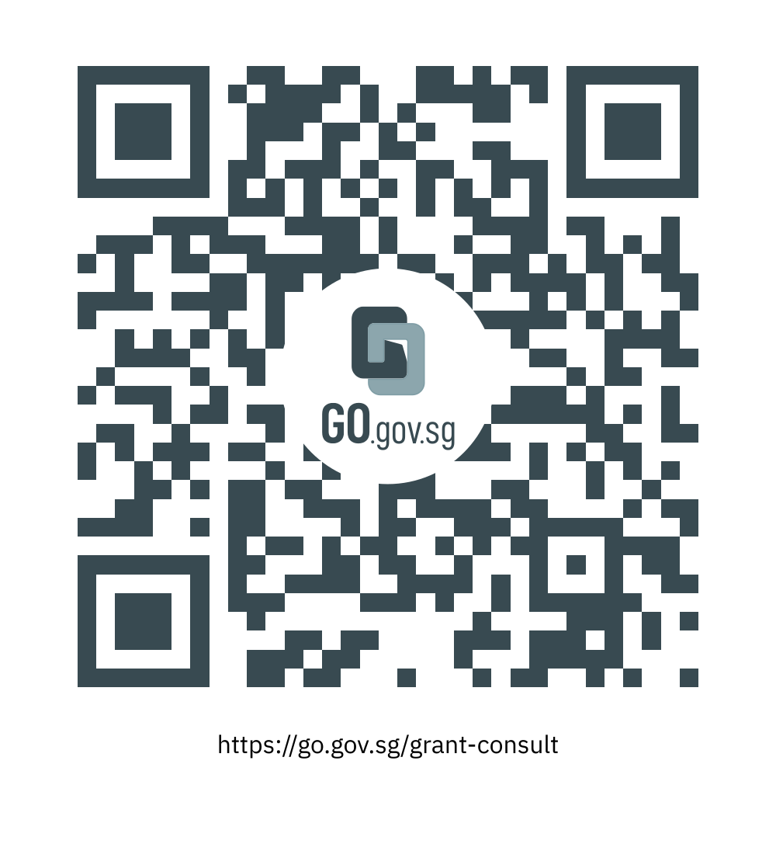
Application process for Youth sector organisations
Partnership Grant Call YSO journey
21 Nov 2024 – 19 Feb 2025
Dec 2024, Jan 2025
Mar – Jul 2025
Aug 2025 onwards
Apply
Clarify
Approval/ Rejection
Project Implementation
Apply for NYF grant via OSG portal, in window period, using CorpPass.
Submit all relevant documents, including Proposal, outcomes for project, logic model.
Applications should be at least 2-3 months before the start of the project. Project with >$50k grant request should submit at least 3 months before the start of project.
For requested grant amounts up to $100k, results within 8 – 12 weeks
For project assessed of a grant amount of >$100k, NYC will invite applicants to pitch their proposal.
Acknowledge Letter of Award and Annexes stating approved NYF grant amount and the grant’s Terms & Conditions; or
If unsuccessful, applicant will receive notification of Rejection, via OSG.
Projects should commence by Aug 2025.
1st Disbursement typically within 4 weeks from acceptance of Letter of Award.
1st disbursement will be up to 50% of approved grant amount.
The remaining grant will be on reimbursement based on project milestones and KPIs.
1-on-1 AskPL Grant Consult Clinics (4 Dec/ 18 Dec/ 15 Jan) to raise enquiries and discuss proposal ideas
Applicant may begin outreach to other stakeholders, or apply for co-funding from other sources
Notes:
Grant Clinics in Dec and Jan: https://go.gov.sg/grant-consult

Slide 7
Annex A
NYC Outcomes Measurement
for Youth Wellbeing Grant Call

Slide 8
Themes (1/2) | Outcomes | Indicators (Pre-Post) | Validated Scales
Caring for Self: Holistic Well-Being Target: Youths (recipients) Objective: Build intrapersonal and interpersonal resources within youths to enable them to manage their well-being and self-help. Outcome: Youths are thriving and have a positive sense of well-being. Future-ready [YDO] I am confident about my future as a whole.* | Resilience Youths are more confident, versatile, and better equipped to deal with stressors and recover from set-backs. (e.g., coping skills, stress management techniques) | Confidence [YDO] I believe I have the ability to succeed in the things I want to do.* I am confident I can succeed when I try my best. Tenacity [YDO] I am able to persevere in the face of challenges.* I do not give up even after experiencing failure. | Self-Perception Resilience: Brief Resilience Scale (BRS) Coping Competence & Confidence: Coping Competence Questionnaire (CCQ), Coping Self-Efficacy Scale (CSES) Experience of Stress: Perceived Stress Scale (PSS)
 | Self-management Youths are more self-aware and adept at monitoring and managing their well-being in daily life. (e.g., self-care strategies, goal-setting) | Self-Empowerment [Prog Feedback] I understand the factors that contribute to my overall well-being. I believe it is important to prioritise my wellbeing.* I make a conscious effort to manage my well-being. Proactiveness [Prog Feedback] I take initiative to manage my well-being.* I seize the opportunity to improve my well-being whenever I see one. | Sense of Empowerment: Personal Empowerment Scale (PES) Self-Efficacy: Mindfulness-Based Self-Efficacy Scale – Revised (MSES-R), Equanimity and Taking Responsibility Subscales Self-Care Behaviours/ Actions: Mindful Self-Care Scale (MSCS)
 | Help-seeking Youths are more prepared to navigate well-being resources and access/ utilise support in schools, workplaces and community. (e.g., wayfinding, self-expression) | Self-Advocacy [Prog Feedback] I am aware of resources that can enhance my well-being.* I would seek help when faced with challenges that I cannot manage alone.* I am able to express my needs and ask for support in various settings. | Help-Seeking Attitudes: General Help-Seeking Questionnaire (GHSQ)
 | Social capital Youths are able to identify and build support networks in their communities. (e.g., mentoring, social mixing) | Relationship-Building [Prog Feedback] I believe it is important to foster a sense of belonging and support. I can build and maintain supportive relationships.* | Perceived Support: Perceived Social Support Scale (PSSS) Connectedness: Social Connectedness Scale – Revised (SCS-R)
Question type
 | Awareness
 | Attitude
 | Behaviour
 | State
* compulsory statements

Slide 9
Themes (2/2) | Outcomes | Indicators (Pre-Post) | Validated Scales
Caring for Others: Strong Support Systems (Peers, Family & Workplace) Targets: Youths (supporters) Mentors / non-youth peers Family members Workplaces Objective: Strengthen quality of stakeholder support to create a robust culture of care. Outcome: Youths/ Stakeholders are equipped with knowledge and skills to support others in improving their well-being Committed to SG [YDO] I have a part to play in developing Singapore for the benefit of current and future generations.* | Interpersonal awareness Youths/ stakeholders know how to observe, recognise, and understand the emotions, needs, and concerns of others. | Empathy [YDO] I put myself in the shoes of others to understand how they feel.* Recognition of Needs [Prog Feedback] I can identify when others are in need of support. | Emotional Intelligence: Schutte Self-Report Emotional Intelligence Test (SSEIT) Emotional Competence: Profile of Emotional Competence (PEC)
 | Responsive support Youths/ stakeholders feel better prepared to support others in a way that is responsive to their needs. | Capacity to Support [Prog Feedback} I understand the ways that I can care for others. I know how to tailor support to meet individual needs. I am aware of the effects of my actions on others. I am able to support those in need.* My efforts to care for others will make a difference. I encourage my [peers/ youths] to participate in activities that promote well-being. | Quality of Support: Intentional Peer Support Core Competencies Scale (IPSCC)

Slide 10
Domains | Outcomes | Indicators (Pre-Post) | Validated Scales
Mental Well-being | Youths are happy, resilient, and confident in managing stress. | Emotional Awareness [YDO] I know how to identify symptoms of mental and emotional distress.* Emotional Management [YDO] I know how I can manage negative thoughts and emotions.* I know where to seek help when I have distressing thoughts and emotions beyond my control. If I have distressing thoughts and emotions beyond my control, I would seek help. Emotional Support [YDO] I am able to support those struggling mentally and emotionally.* | Mental Help Seeking Attitudes Scale (MHSAS) Mental Help Seeking Intentions Scale (MHSIS) Barriers to Help-Seeking Scale (BHSS) Self-Stigma of Seeking Help Scale (SSOSH)
Social Well-being | Youths have healthy, meaningful relationships and social connections. | Social Support Networks [YDO] I have people whom I can turn to for support.* I have people that I can talk with about my problems. | Perceived support: Perceived Social Support Scale (PSSS) Social Connectedness Scale – Revised (SCS-R)
Financial Well-being | Youths feel secure in their financial future. | Financial Literacy [YDO] I know the steps that I can take to meet my financial goals. | Reported Financial Well-being Scale Affective, Physical, Relational (APR) Financial Stress Scale

Slide 11
Themes (1/2) | Outcomes | Indicators (Post-Only) | Validated Scales
Caring for Self: Holistic Well-Being Target: Youths (recipients) Objective: Build intrapersonal and interpersonal resources within youths to enable them to manage their well-being and self-help. Outcome: Youths are thriving and have a positive sense of well-being. Future-ready [YDO] I am more confident about my future as a whole.* | Resilience Youths are more confident, versatile, and better equipped to deal with stressors and recover from set-backs. (e.g., coping skills, stress management techniques) | Confidence [YDO] I have a stronger belief in my ability to succeed in the things I want to do.* I am more confident I can succeed when I try my best. Tenacity [YDO] I am better able to persevere in the face of challenges.* I am less likely to give up even after experiencing failure. | Self-Perception Resilience: Brief Resilience Scale (BRS) Coping Competence & Confidence: Coping Competence Questionnaire (CCQ), Coping Self-Efficacy Scale (CSES) Experience of Stress: Perceived Stress Scale (PSS)
 | Self-management Youths are more self-aware and adept at monitoring and managing their well-being in daily life. (e.g., self-care strategies, goal-setting) | Self-Empowerment [Prog Feedback] I am better able to understand the factors that contribute to my overall well-being. I have a stronger belief that it is important to prioritise my wellbeing.* I am more likely to make a conscious effort to manage my well-being. Proactiveness [Prog Feedback] I am more likely to take initiative to manage my well-being.* I am more likely to seize the opportunity to improve my well-being whenever I see one. | Sense of Empowerment: Personal Empowerment Scale (PES) Self-Efficacy: Mindfulness-Based Self-Efficacy Scale – Revised (MSES-R), Equanimity and Taking Responsibility Subscales Self-Care Behaviours/ Actions: Mindful Self-Care Scale (MSCS)
 | Help-seeking Youths are more prepared to navigate well-being resources and access/ utilise support in schools, workplaces and community. (e.g., wayfinding, self-expression) | Self-Advocacy [Prog Feedback] I am more aware of resources that can enhance my well-being.* I am more likely to seek help when faced with challenges that I cannot manage alone.* I am better able to express my needs and ask for support in various settings. | Help-Seeking Attitudes: General Help-Seeking Questionnaire (GHSQ)
 | Social capital Youths are able to identify and build support networks in their communities. (e.g., mentoring, social mixing) | Relationship-Building [Prog Feedback] I have a stronger belief that it is important to foster a sense of belonging and support. I am better able to build and maintain supportive relationships.* | Perceived Support: Perceived Social Support Scale (PSSS) Connectedness: Social Connectedness Scale – Revised (SCS-R)
Question type
 | Awareness
 | Attitude
 | Behaviour
 | State
* compulsory statements

Slide 12
Themes (2/2) | Outcomes | Indicators (Post-Only) | Validated Scales
Caring for Others: Strong Support Systems (Peers, Family & Workplace) Targets: Youths (supporters) Mentors / non-youth peers Family members Workplaces Objective: Strengthen quality of stakeholder support to create a robust culture of care. Outcome: Youths/ Stakeholders are equipped with knowledge and skills to support others in improving their well-being Committed to SG [YDO] I have a stronger belief that I have a part to play in developing Singapore for the benefit of current and future generations.* | Interpersonal awareness Youths/ stakeholders know how to observe, recognise, and understand the emotions, needs, and concerns of others. | Empathy [YDO] I am better equipped to put myself in the shoes of others to understand how they feel.* Recognition of Needs [Prog Feedback] I can better identify when others are in need of support. | Emotional Intelligence: Schutte Self-Report Emotional Intelligence Test (SSEIT) Emotional Competence: Profile of Emotional Competence (PEC)
 | Responsive support Youths/ stakeholders feel better prepared to support others in a way that is responsive to their needs. | Capacity to Support [Prog Feedback} I better understand the ways that I can care for others. I am more knowledgeable about how to tailor support to meet individual needs. I am more aware of the effects of my actions on others. I am better able to support those in need.* I have a stronger belief that my efforts to care for others will make a difference. I am more likely to encourage my [peers/ youths] to participate in activities that promote well-being. | Quality of Support: Intentional Peer Support Core Competencies Scale (IPSCC)

Slide 13
Domains | Outcomes | Indicators (Post-Only) | Validated Scales
Mental Well-being | Youths are happy, resilient, and confident in managing stress. | Emotional Awareness [YDO] I am more knowledgeable about how to identify symptoms of mental and emotional distress.* Emotional Management [YDO] I am more knowledgeable about how I can manage negative thoughts and emotions.* I am more knowledgeable about where to seek help when I have distressing thoughts and emotions beyond my control. If I have distressing thoughts and emotions beyond my control, I am more likely to seek help. Emotional Support [YDO] I am better able to support those struggling mentally and emotionally.* | Mental Help Seeking Attitudes Scale (MHSAS) Mental Help Seeking Intentions Scale (MHSIS) Barriers to Help-Seeking Scale (BHSS) Self-Stigma of Seeking Help Scale (SSOSH)
Social Well-being | Youths have healthy, meaningful relationships and social connections. | Social Support Networks [YDO] I feel I have people whom I can turn to for support.* I feel I have people that I can talk with about my problems. | Perceived support: Perceived Social Support Scale (PSSS) Social Connectedness Scale – Revised (SCS-R)
Financial Well-being | Youths feel secure in their financial future. | Financial Literacy [YDO] I am more knowledgeable about the steps that I can take to meet my financial goals.* | Reported Financial Well-being Scale Affective, Physical, Relational (APR) Financial Stress Scale

Slide 14

Partner with us!
NYC seeks to partner with you to engage, develop and empower our youths, and this goes beyond funding!
Contact us at Partnership_Enquiries@nyc.gov.sg
For more information on the National Youth Fund, please visit: https://go.gov.sg/nyf

